Slide 1


Welcome to Insight Community Session 01: Basic Statistics

Slide 2

General Rules:
• Keep yourselves on mute at all the times unless asked otherwise. For any queries, put it in the chat and it’ll be taken care of.
• Attendance for the session will be floated randomly during the session. There will be a QR code that you’ll need to scan and mark the attendance.
• There will be assignments that need to be submitted before deadline. They shouldn’t be copied.
• Regular attendance, regular & quality assignment submissions are an integral part of evaluation for the 2nd round of Insight hiring.
• You can reach out to anyone from the Insight team for any query.

Slide 3
I. Population vs Sample

Slide 4
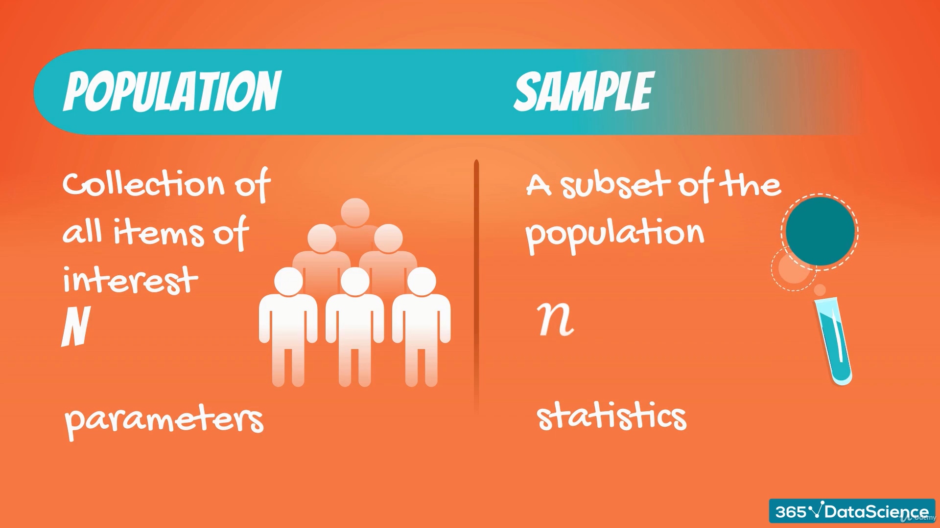


Slide 5
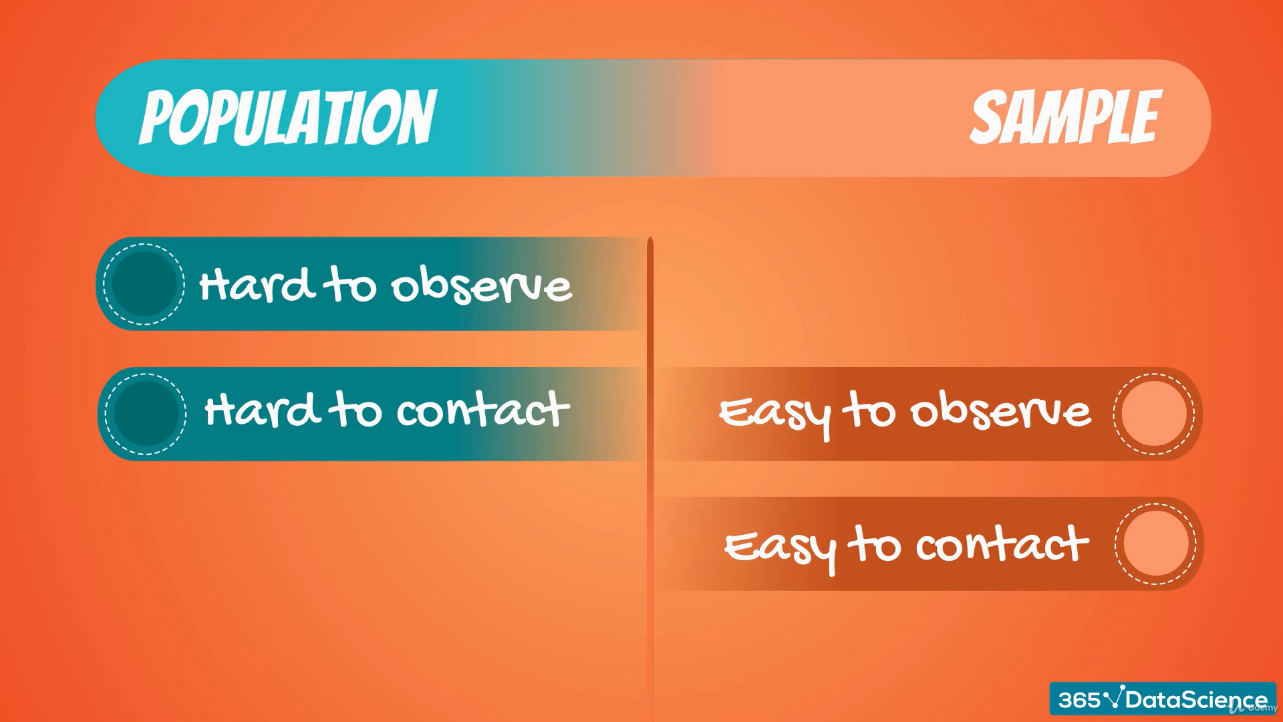

Slide 6
Features of a sample
Randomness | Representativeness
When each member of the sample is chosen from the population strictly by chance. | A subset of the population that accurately reflects the members of the entire population.

Slide 7
II. Type of Variables

Slide 8
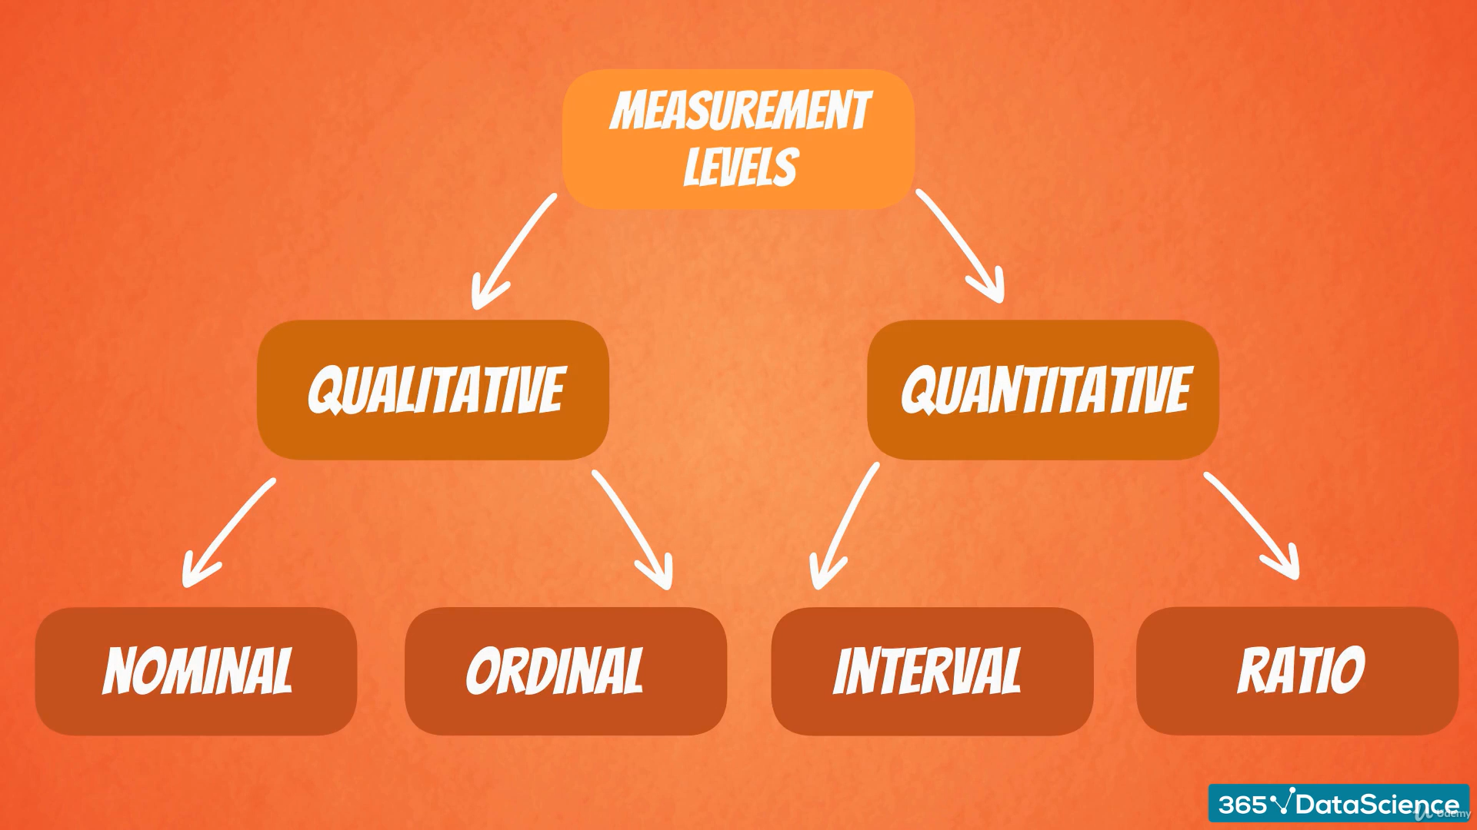

Slide 9

Mercedez
BMW
Audi
(CANNOT BE ORDERED)
Winter
Spring
Summer
Autumn

Slide 10
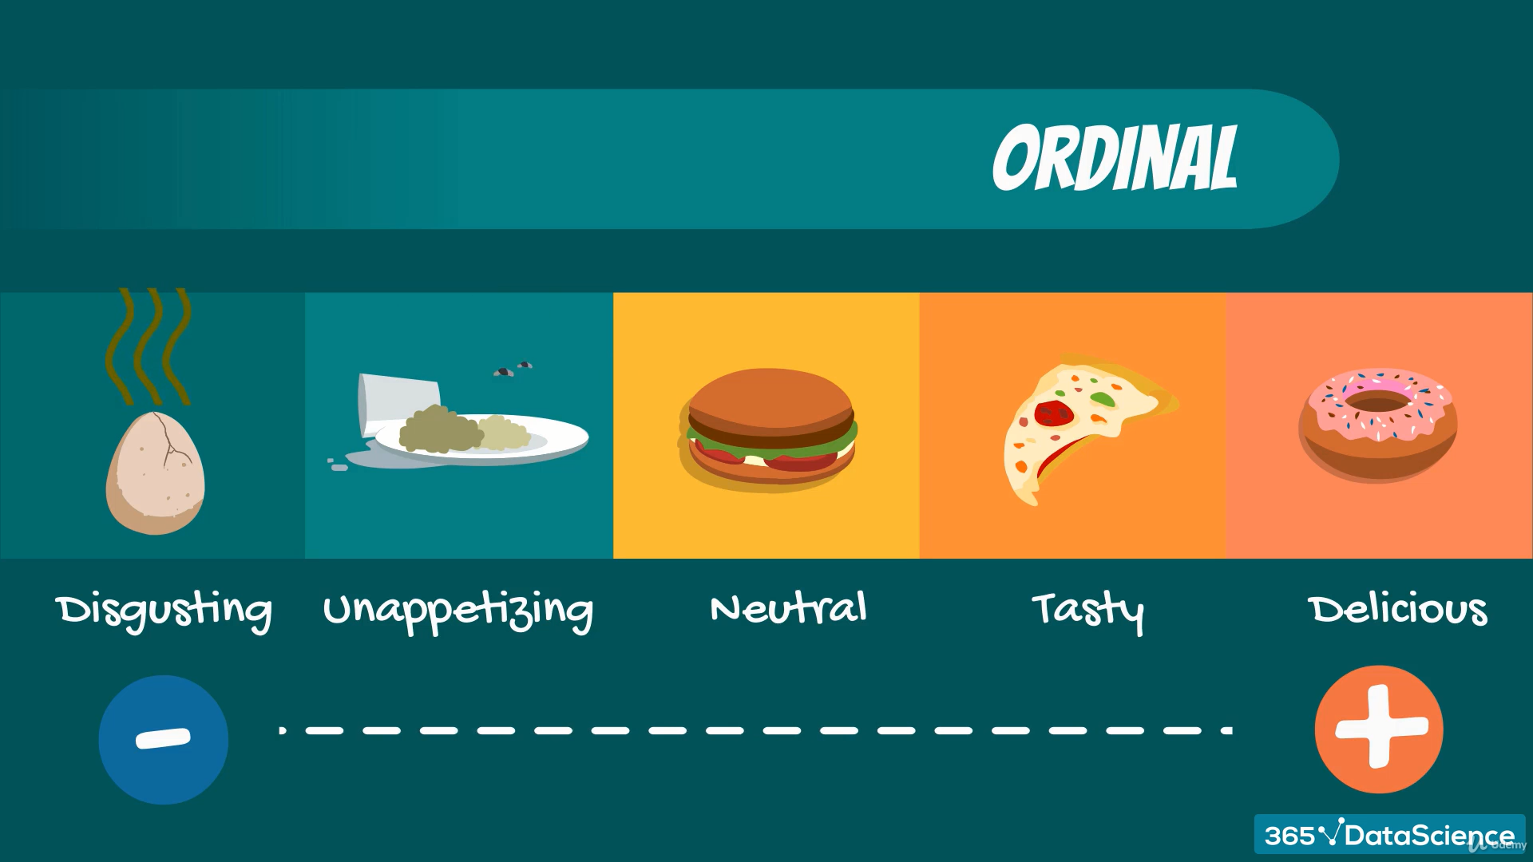
(HAS A SPECIFIED ORDER)

Slide 11
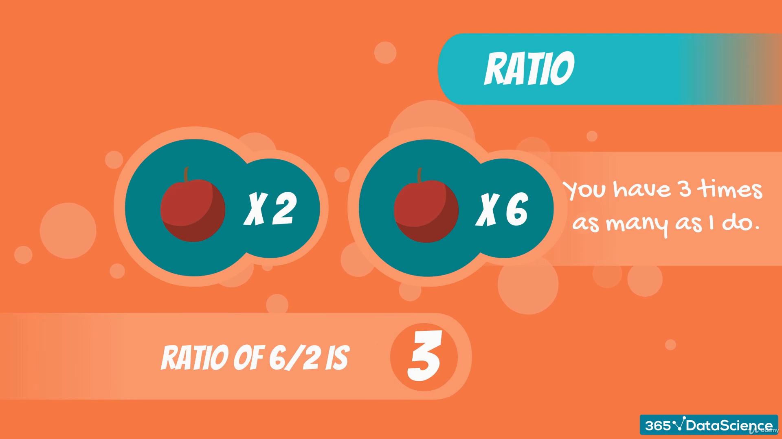
(Ratio has a true zero)

Slide 12
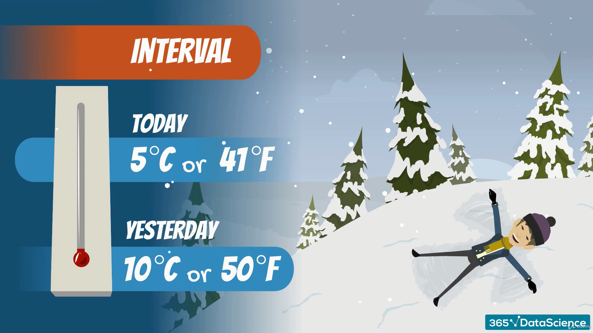
(Interval doesn’t have a true zero)

Slide 13
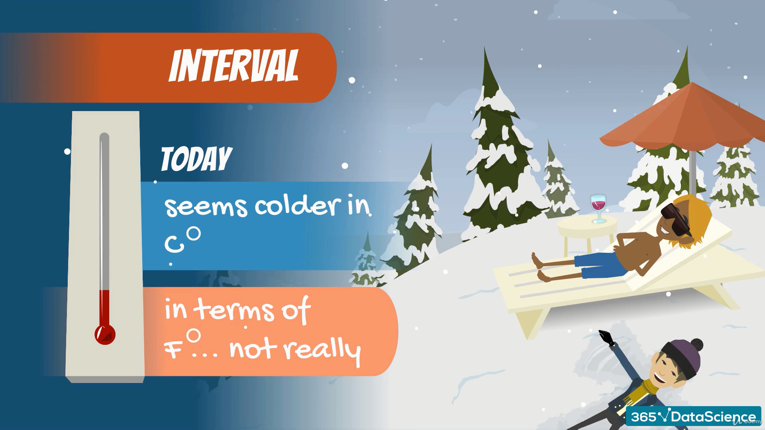

Slide 14
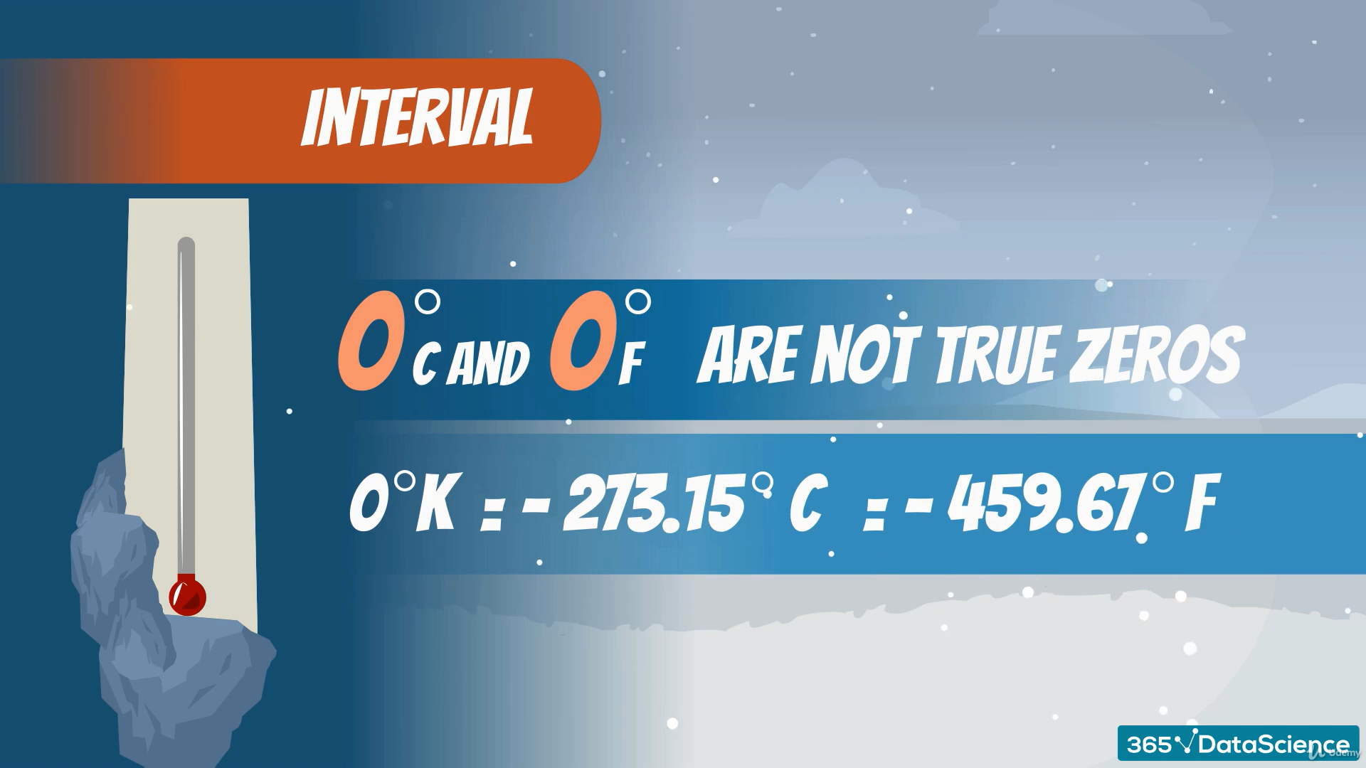

Slide 15
The Temperature Dilemma
0 degree Celsius and 0 degree Fahrenheit are not true zeroes
These scales were artificially created by humans for convenience
0 degree Kelvin is a true zero. That is the coldest anything can get.
Variables in Kelvin are Ratios while Variables in Celsius & Fahrenheit are Intervals.
All numbers like 1, 2, 3, 10, 12.42342, e, pi, etc. can be both Interval and Ratio.
Just be careful of the context you are operating in!!

Slide 16
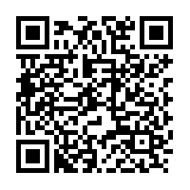
Attendance time !!

Slide 17
III. Distributions

Slide 18
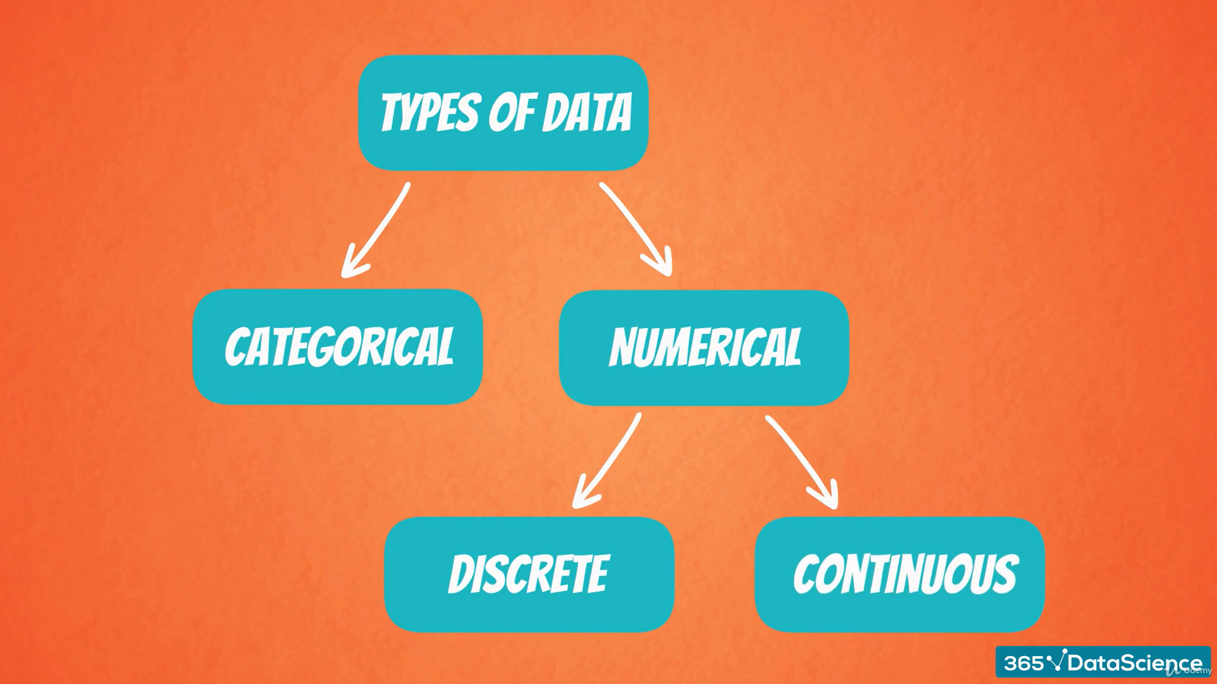

Slide 19
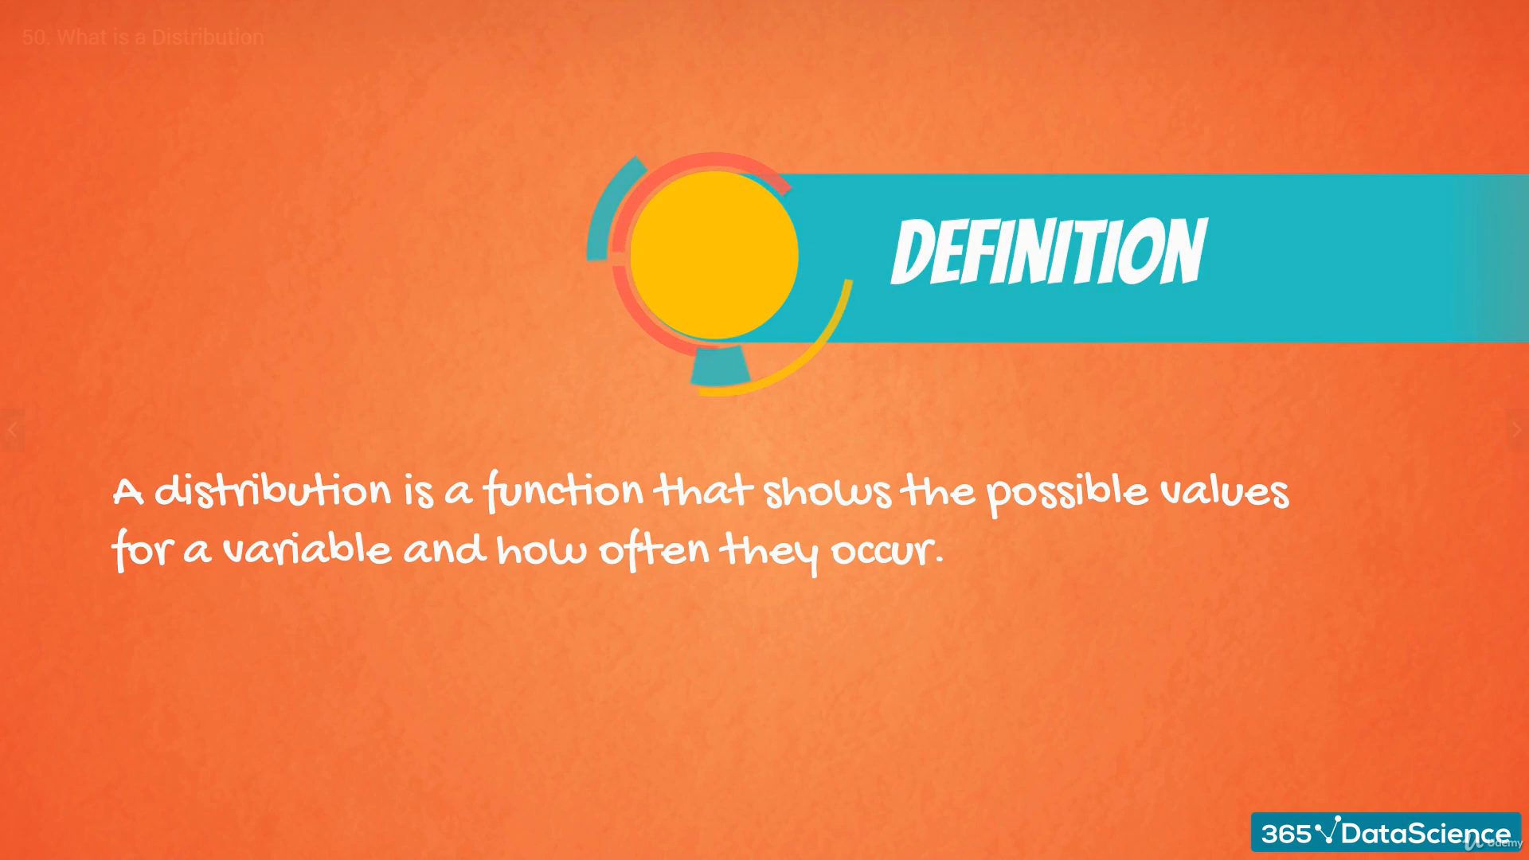

Slide 20
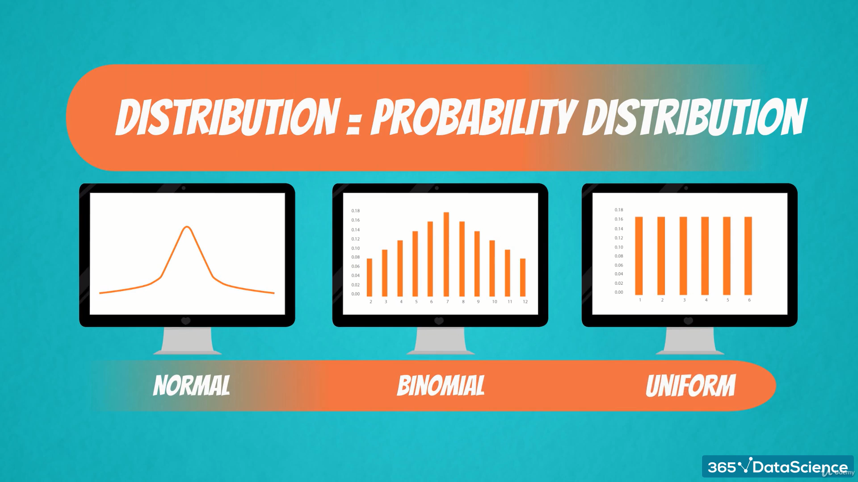

Slide 21
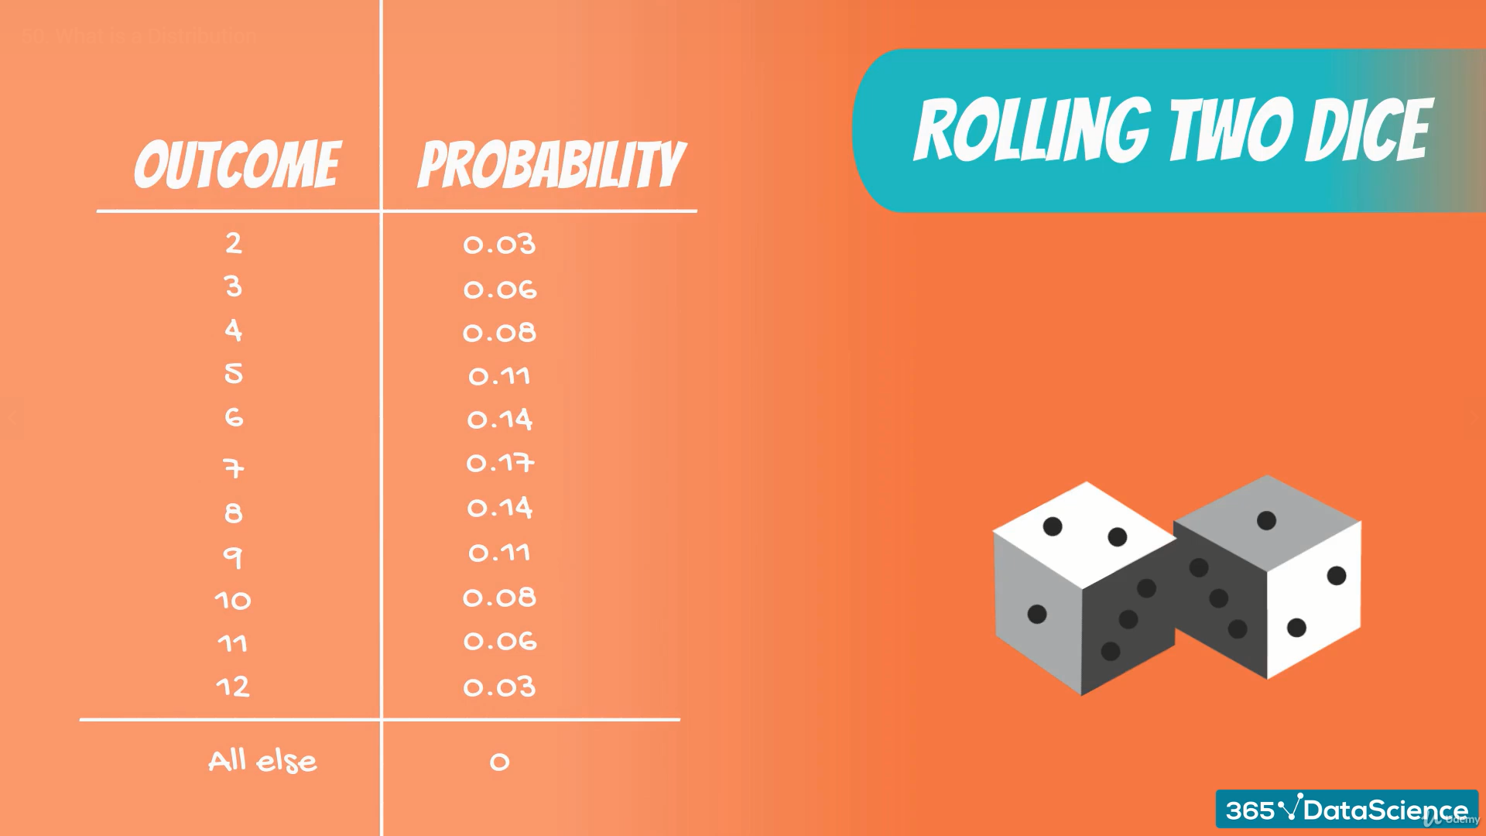

Slide 22


Slide 23
III.a. Normal Distribution

Slide 24
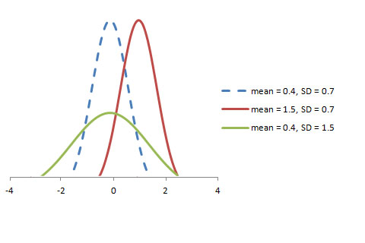
Normal Distribution:
The mean, median and mode of the distribution coincide.
The curve of the distribution is bell-shaped and symmetrical about the line x=μ.
The total area under the curve is 1.
Exactly half of the values are to the left of the centre and the other half to the right.

Slide 25
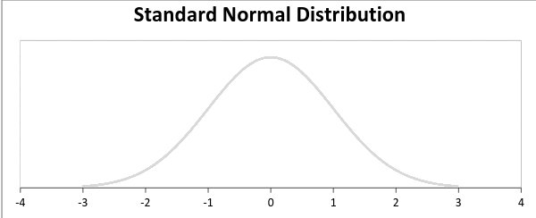
Standard Normal Distribution:
A standard normal distribution is defined as the distribution with mean 0 and standard deviation 1

Slide 26
III.b. Poisson Distribution

Slide 27
Poisson Distribution:
Assumptions:
Any successful event should not influence the outcome of another successful event
The probability of success over a short interval must equal the probability of success over a longer interval
The probability of success in an interval approaches zero as the interval becomes smaller
Examples:
The number of emergency calls recorded at a hospital in a day.
The number of thefts reported in an area on a day.
The number of customers arriving at a salon in an hour.

Slide 28
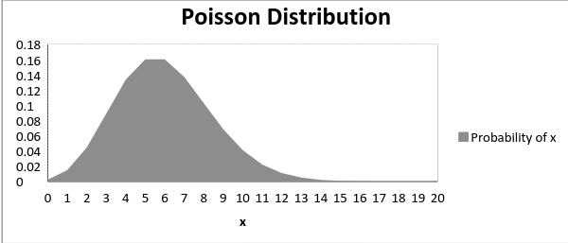
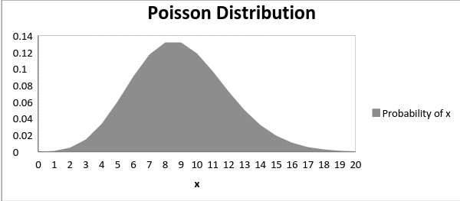
Poisson Distribution:
The graph shown below illustrates the shift in the curve due to increase in mean.
It is perceptible that as the mean increases, the curve shifts to the right.

Slide 29
III.c. Binomial Distribution

Slide 30
Binomial Distribution:
A distribution where only two outcomes are possible, such as success or failure, gain or loss, win or lose and where the probability of success and failure is same for all the trials is called a Binomial Distribution
The parameters of a binomial distribution are n and p where n is the total number of trials and p is the probability of success in each trial.
Features:
Each trial is independent
There are only two possible outcomes in a trial- either a success or a failure
A total number of n identical trials are conducted
The probability of success and failure is same for all trials (Trials are identical)

Slide 31
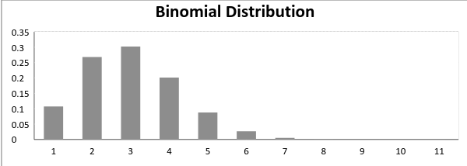
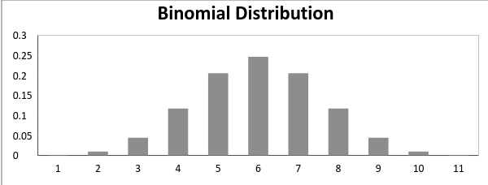
Binomial Distribution:
A binomial distribution graph where the probability of success does not equal the probability of failure looks like
Now, when probability of success = probability of failure, in such a situation the graph of binomial distribution looks like

Slide 32
III.d. Bernoulli Distribution

Slide 33
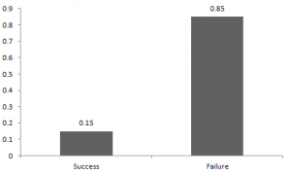
Bernoulli Distribution:
It has only two possible outcomes, namely 1 (success) and 0 (failure), and a single trial
The probabilities of success and failure need not be equally likely, like the result of a fight between me and Undertaker. He is pretty much certain to win. So in this case probability of my success is 0.15 while my failure is 0.85.

Slide 34
III.e. Uniform Distribution

Slide 35
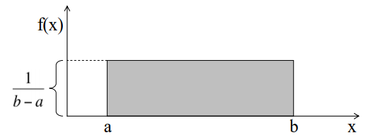
Uniform Distribution:
When you roll a fair die, the outcomes are 1 to 6. The probabilities of getting these outcomes are equally likely and that is the basis of a uniform distribution. Unlike Bernoulli Distribution, all the n number of possible outcomes of a uniform distribution are equally likely.
The graph of a uniform distribution curve looks like
You can see that the shape of the Uniform distribution curve is rectangular, the reason why Uniform distribution is called rectangular distribution.

Slide 36
Thank you…

